Slide 1

- because every second matters in saving a life.
ELECTRO-SAPIENS | Hackathon 2025 | HARDWARE

Slide 2
🩺 Validated Problem Statement Summary
In hospitals, one nurse monitors 10+ patients simultaneously, making it impossible to continuously observe all patients. Even small distractions can lead to missed critical events like sudden drops in oxygen levels, blood pressure crashes, or falls, resulting in preventable deaths and delayed emergency response.
Root Cause
Caregivers cannot physically monitor multiple patients at once.
Traditional systems rely on centralized monitoring with infrastructure dependencies.
No immediate, wearable alert system for caregivers.
Impact
⚠️ Preventable patient deaths from undetected vital deterioration
😓 Caregiver stress and burnout
💰 Increased healthcare costs from adverse events
Solution Goal
Enable one caregiver to effectively monitor 10+ patients through real-time wearable vital monitoring with instant alerts, ensuring no critical health event goes unnoticed.

Slide 3
🎯 Key User Pain Point Addressed
The key user pain point addressed by the Vital Watch project is the difficulty nurses and caretakers face in continuously monitoring multiple patients simultaneously.
In real hospital scenarios:
A single nurse is often assigned to care for several patients at once.
It’s impossible to constantly observe every patient’s vital signs like oxygen level, ECG, or blood pressure in real time.
Delays in detection of critical health drops or sudden falls can lead to life-threatening emergencies.
Vital Watch solves this by providing a real-time, automatic alert system that notifies caretakers the moment any abnormal vital signs are detected — eliminating dependence on manual checks or continuous supervision.

Slide 4
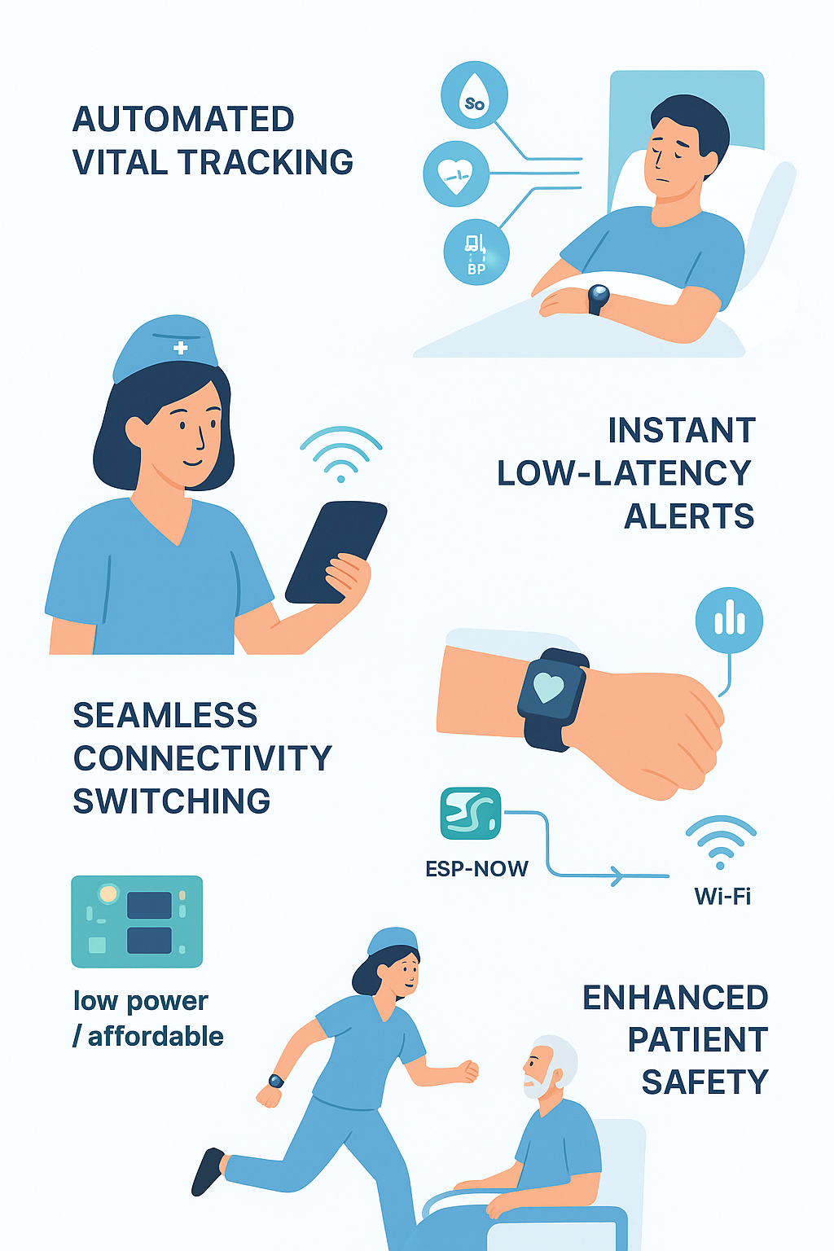
🎯 Objective of the Prototype
The main objective of the Vital Watch prototype is to demonstrate a reliable, real-time health monitoring system that can continuously track patient vitals such as oxygen level, ECG, blood pressure, and fall detection, and instantly alert caretakers when abnormalities occur.
The prototype aims to:
✅ Reduce the dependency on manual monitoring by automating vital tracking.
✅ Enable instant, low-latency alerts using the ESP-NOW protocol for peer-to-peer communication.
✅ Ensure continuous connectivity by intelligently switching between ESP-NOW and Wi-Fi based on range.
✅ Prove feasibility of a low-power, low-cost wearable solution for hospital and healthcare environments.
✅ Enhance patient safety by enabling faster response times during emergencies.

Slide 5
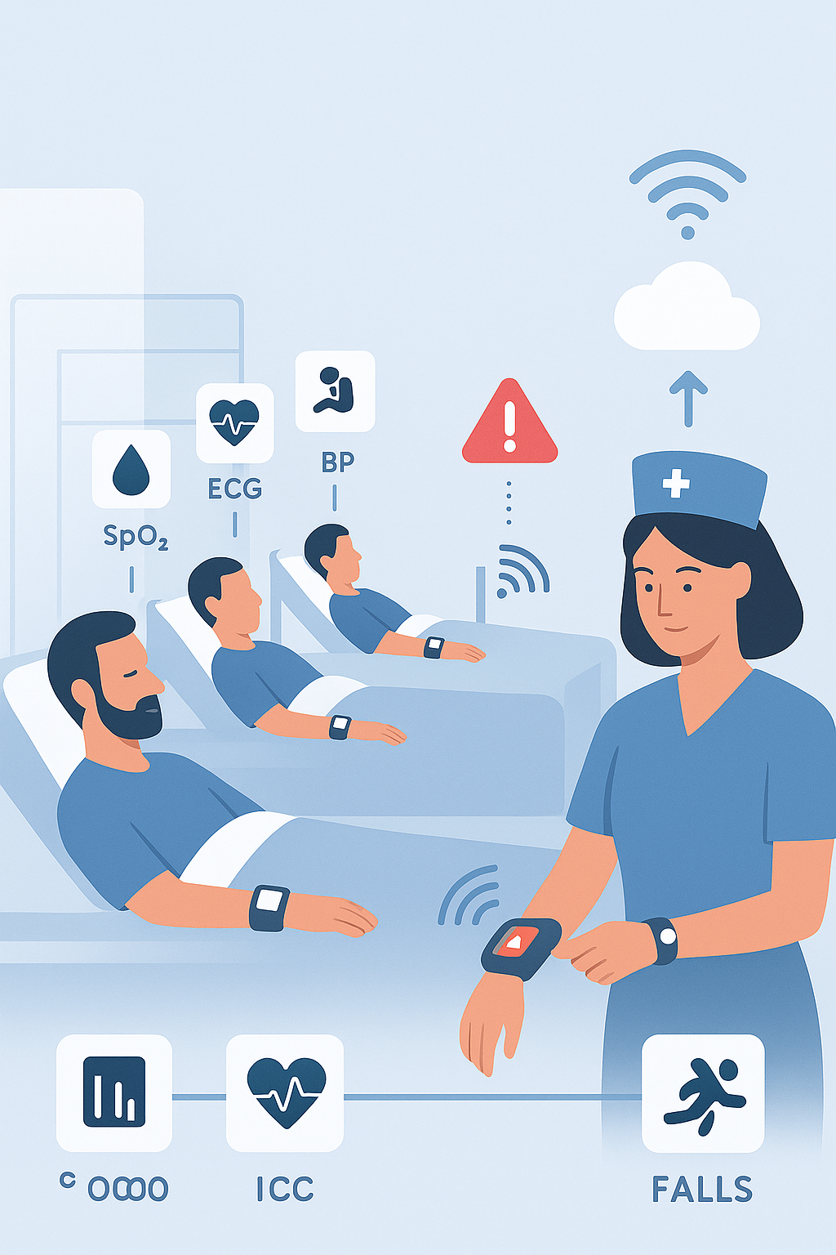
⚙️ Prototype Description
The Vital Watch prototype is a smart health monitoring system designed to continuously track and transmit a patient’s vital signs in real time. It consists of two main components — patient-side devices (slaves) and a caretaker-side device (master) — both powered by ESP32 microcontrollers.
Each patient device collects data from sensors such as:
Pulse Oximeter (SpO₂ Sensor) – measures oxygen level and heart rate.
ECG Sensor – monitors heart activity.
Blood Pressure Sensor – tracks BP levels.
Accelerometer – detects falls or sudden movements.
The collected data is sent to the nurse’s master device using the ESP-NOW protocol, which allows fast, peer-to-peer communication without requiring Wi-Fi or an internet connection. If the nurse moves out of range, the system automatically switches to Wi-Fi mode, ensuring continuous connectivity and alerts.
When any abnormal condition is detected — like low oxygen, irregular ECG, or a fall — the nurse’s watch immediately displays an alert, enabling quick medical response.

Slide 6

⚙️ Technologies Involved

Slide 7
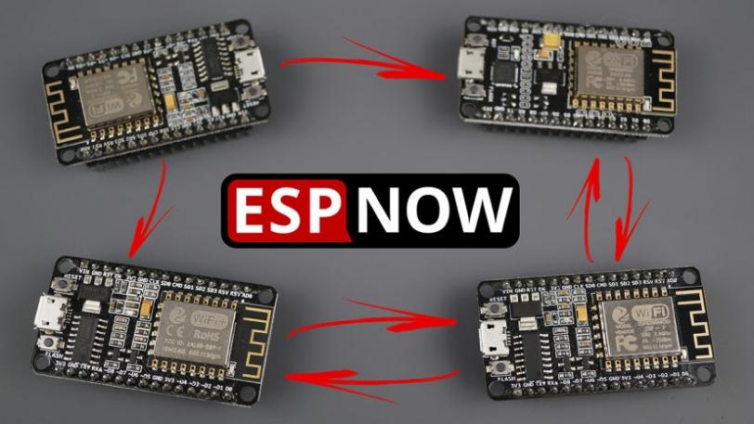
📡 ESP-NOW Protocol
🌐 Wi-Fi Connectivity
🔋 Power Management System
A low-power, peer-to-peer wireless communication protocol developed by Espressif. It allows multiple ESP32 devices to exchange data instantly without needing Wi-Fi or an internet connection. This ensures real-time monitoring and ultra-fast alerts in local environments.
💾 Embedded Firmware – Arduino IDE
🖥️ EasyEDA

Slide 8
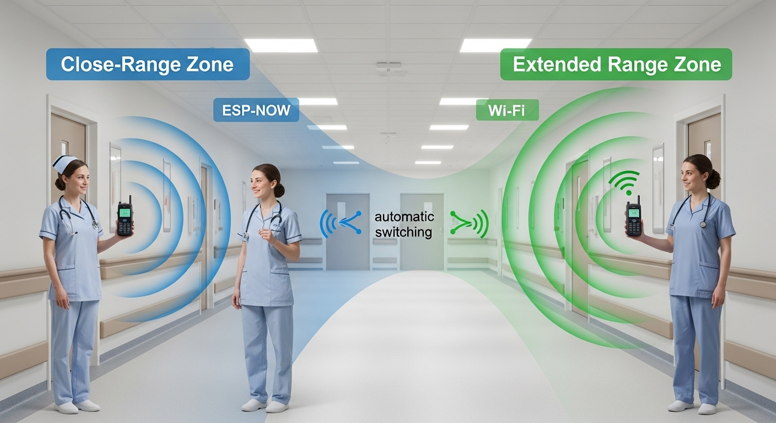
📡 ESP-NOW Protocol
🌐 Wi-Fi Connectivity
🔋 Power Management System
Used as a backup communication method when devices move beyond the ESP-NOW range. The system automatically switches to Wi-Fi to maintain continuous communication between nurse and patient devices.
💾 Embedded Firmware – Arduino IDE
🖥️ EasyEDA

Slide 9
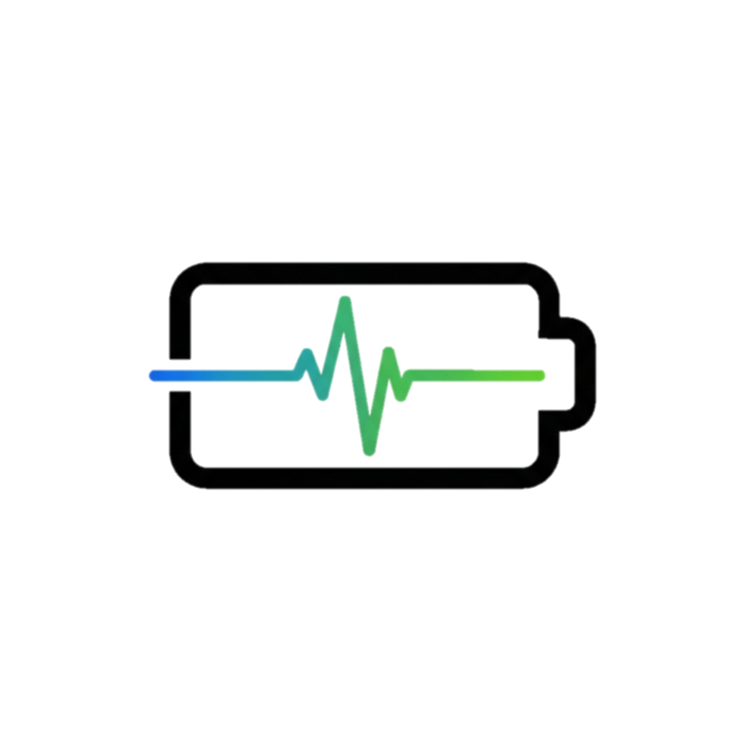
📡 ESP-NOW Protocol
🌐 Wi-Fi Connectivity
🔋 Power Management System
Incorporates battery monitoring and efficient power regulation to ensure long operation hours for wearable devices.
💾 Embedded Firmware – Arduino IDE
🖥️ EasyEDA

Slide 10

📡 ESP-NOW Protocol
🌐 Wi-Fi Connectivity
🔋 Power Management System
Custom firmware developed for both master and slave devices manages data collection, communication, and alert logic.
💾 Embedded Firmware – Arduino IDE
🖥️ EasyEDA

Slide 11

📡 ESP-NOW Protocol
🌐 Wi-Fi Connectivity
🔋 Power Management System
The PCB and schematic are designed in EasyEDA, enabling compact, reliable, and production-ready hardware layouts.
💾 Embedded Firmware – Arduino IDE
🖥️ EasyEDA

Slide 12
“Simple User Journey” (for Vital Watch)

Slide 13
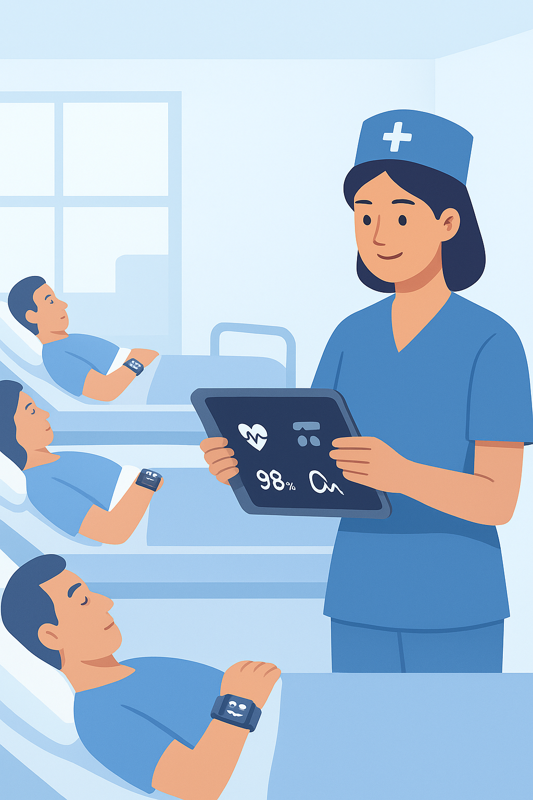
1.Patient Setup:
The nurse assigns a Vital Watch device to each patient. The watch automatically starts collecting vitals like heart rate, SpO₂, and ECG.

Slide 14
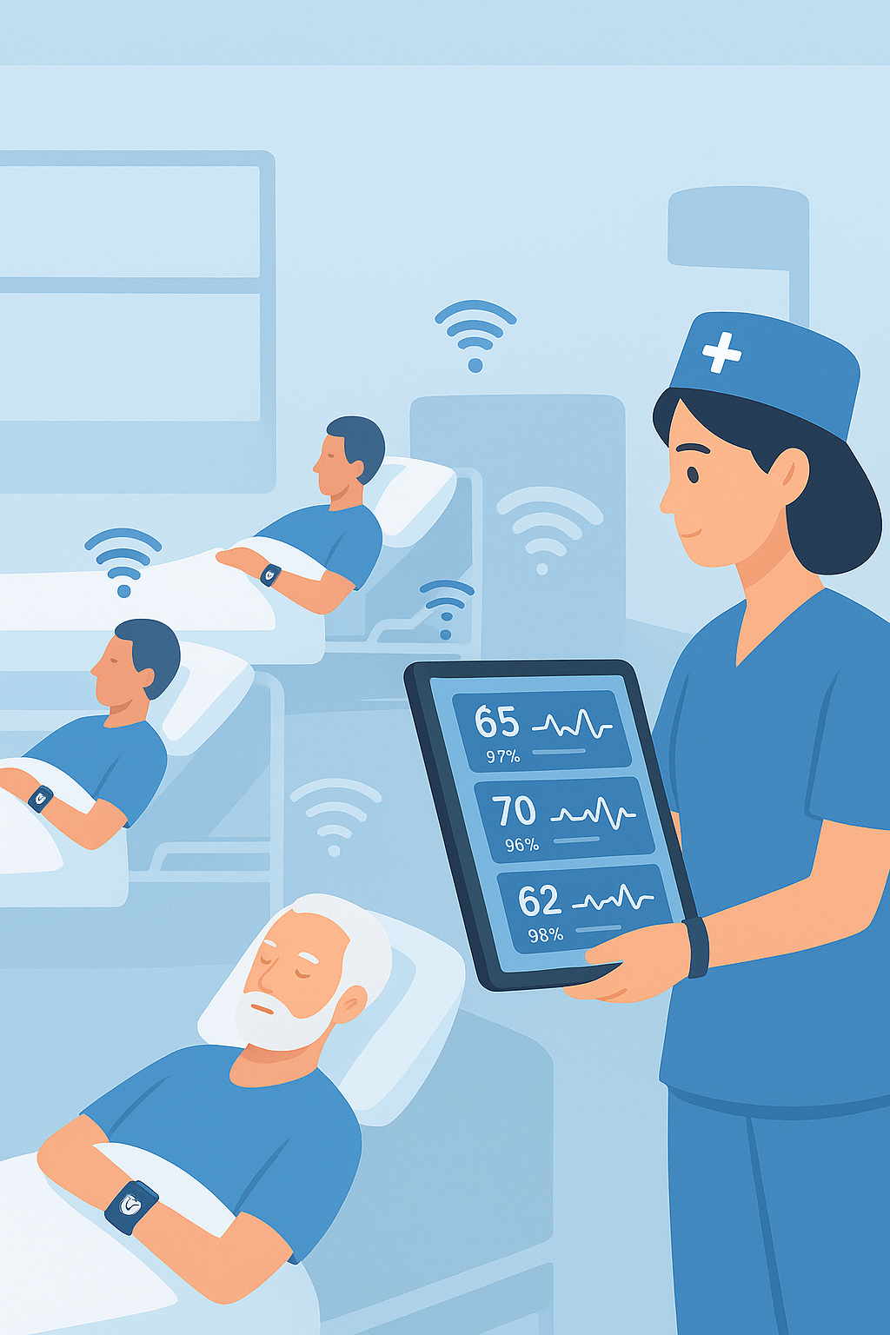
2.Data Transmission:
Each patient’s device sends the health data to the nurse’s central watch (or display) using ESP-NOW.

Slide 15
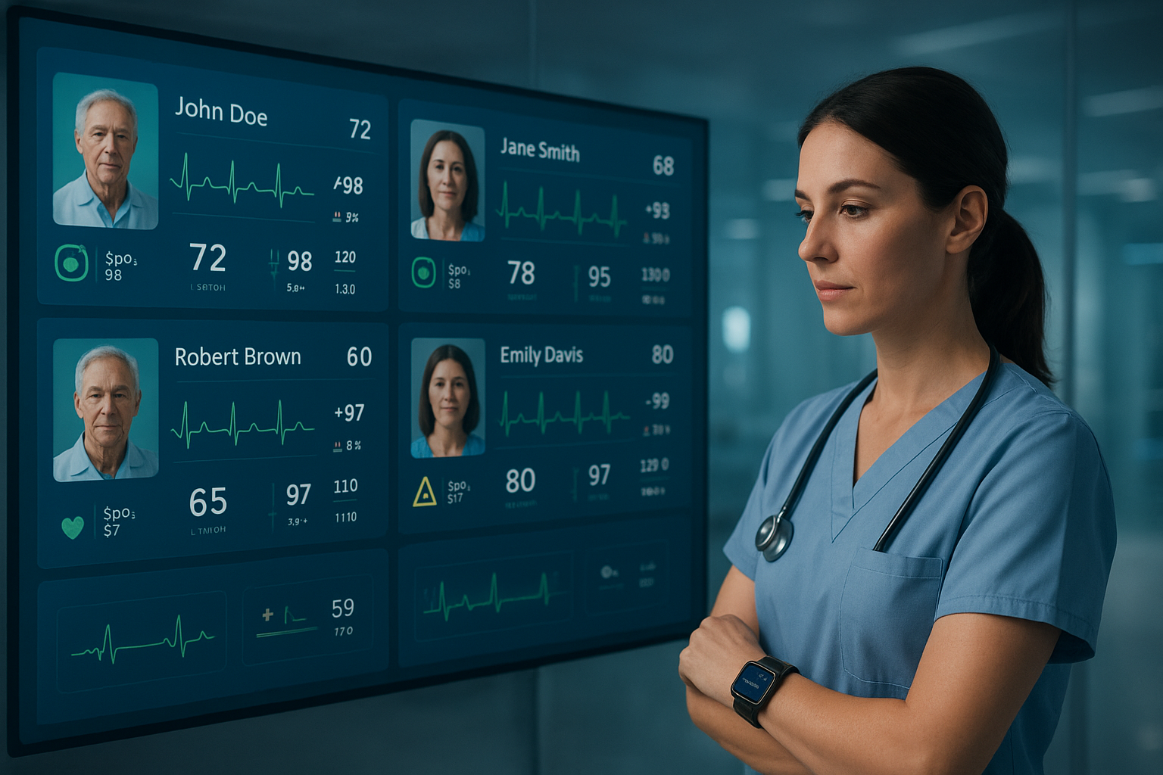
3.Monitoring Phase:
The nurse views all patients’ live health parameters on her screen or smartwatch.

Slide 16
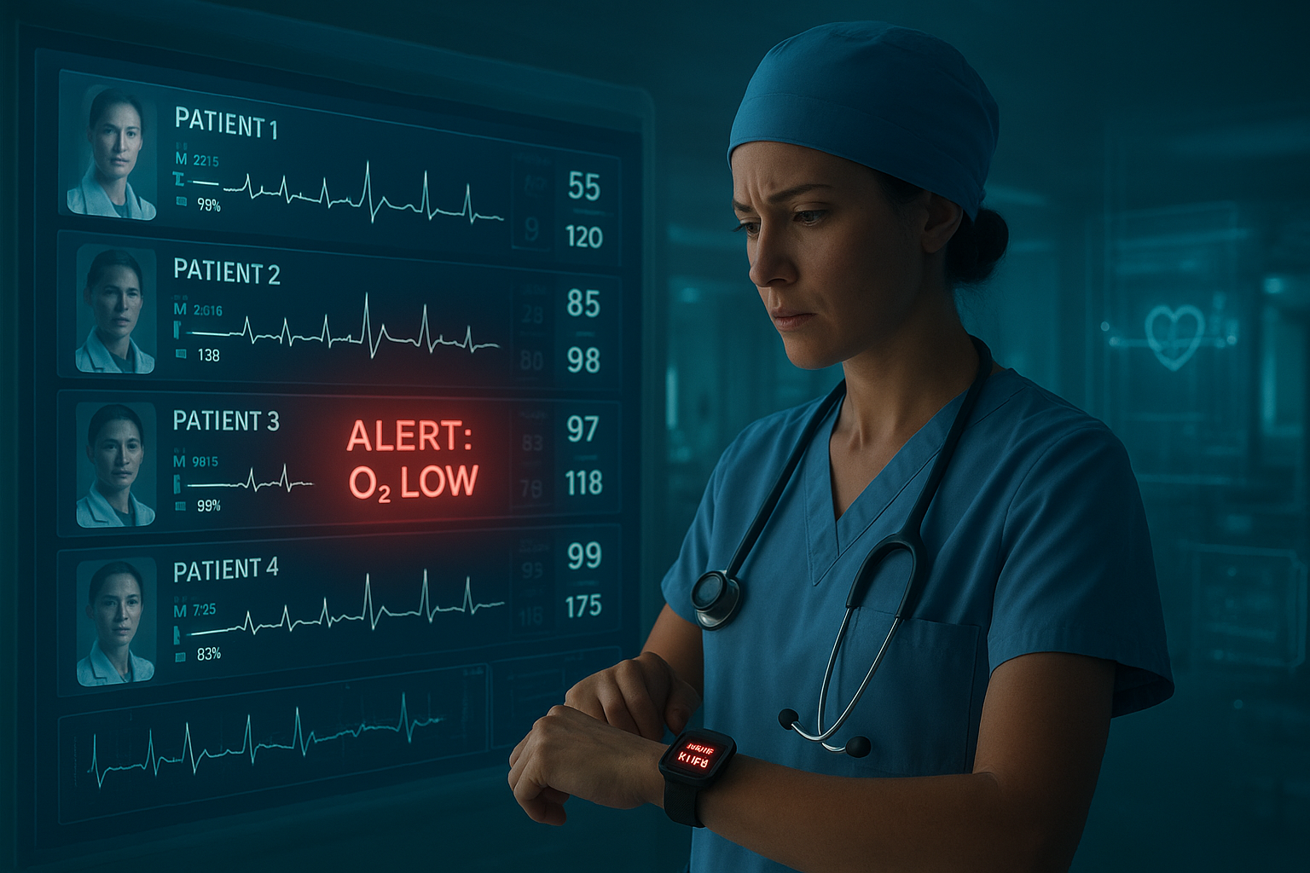
4.Alert Event:
Suddenly, one patient’s oxygen level drops below normal. → The nurse’s device vibrates or flashes a red alert message.

Slide 17

5.Response:
The nurse immediately attends to that patient, potentially preventing a medical emergency.

Slide 18

Why it’s unique or Innovative ??

Slide 19
Enables direct peer-to-peer communication between multiple devices without the need for Wi-Fi, internet, or a router.
🔗 ESP-NOW Protocol Integration:

Slide 20
⚡ Ultra-Low Latency Communication
The ESP-NOW protocol provides instant data transfer with minimal delay — crucial for real-time health monitoring and emergency alerts.

Slide 21
🔄 Smart Network Switching
The system automatically switches from ESP-NOW to Wi-Fi when the caretaker moves out of local range, ensuring continuous connectivity.

Slide 22
Combines the range of Wi-Fi and the speed of ESP-NOW, maintaining efficient data transmission in all conditions.
🌐 Hybrid Communication Model

Slide 23
One master device (nurse) can communicate with multiple slave devices (patients) simultaneously, enabling centralized monitoring.
🧠 Multi-Device Support

Slide 24
💡 No Dependency on Internet
Vital alerts can be exchanged even without any external network, making it ideal for hospitals with limited or unstable Wi-Fi.

Slide 25
🔋 Energy Efficient Design
ESP-NOW consumes significantly less power compared to Wi-Fi or Bluetooth, extending battery life for continuous operation.

Slide 26
🧭 Next Steps for Scaling and Refinement
Hardware Optimization:
Integrate smaller, low-power components to improve comfort and battery life.
Design a compact, production-ready PCB integrating ESP32, sensors, and power management.
Data Reliability & Range Testing:
Conduct large-scale ESP-NOW and Wi-Fi tests in hospital-like environments.
Implement automatic network switching and backup communication modes.
Cloud Integration:
Add cloud-based data logging for long-term health tracking and analytics.
Enable remote monitoring by doctors through a secure web or mobile dashboard.
User Interface Refinement:
Improve nurse and doctor dashboards for real-time visualization and alerts.
Introduce voice or vibration-based notifications for emergencies.
Validation & Certification:
Run clinical validation tests to ensure data accuracy and medical reliability.
Begin regulatory compliance steps (e.g., IEC, ISO for medical electronics).
Scalability & Deployment:
Expand from a few patients to a full ward-level deployment.
Prepare manufacturing-ready design for mass production and pilot trials.

Slide 27
Screenshots & Wireframes

Slide 28
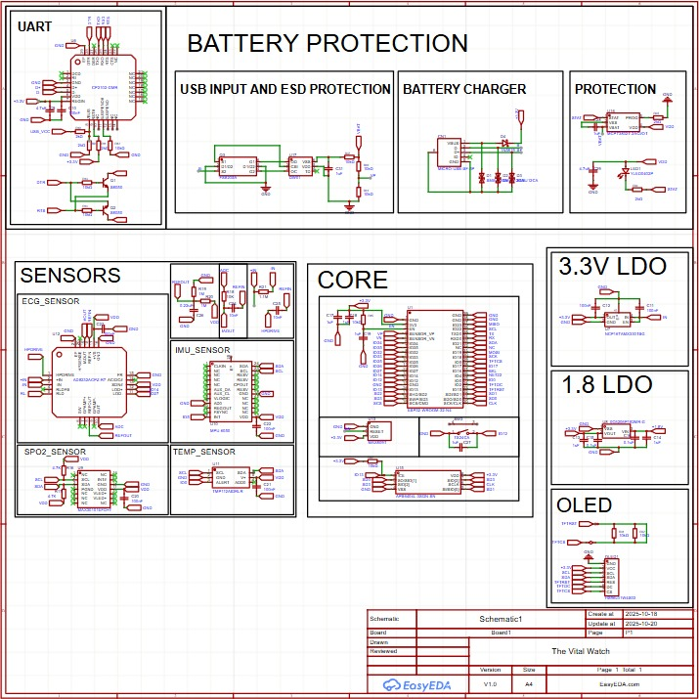
SCHEMATIC OF VITAL WATCH

Slide 29
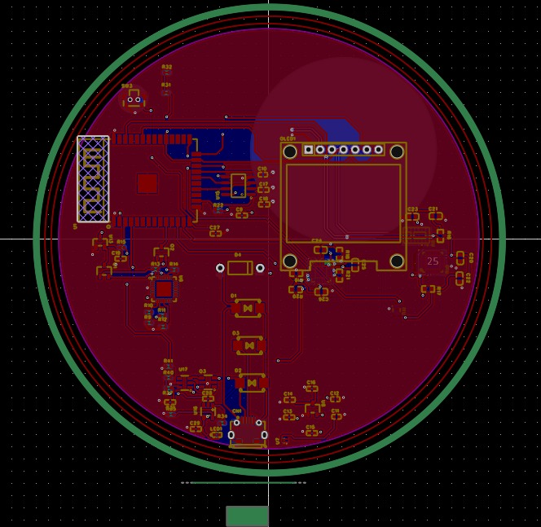
LAYOUT OF VITAL WATCH

Slide 30
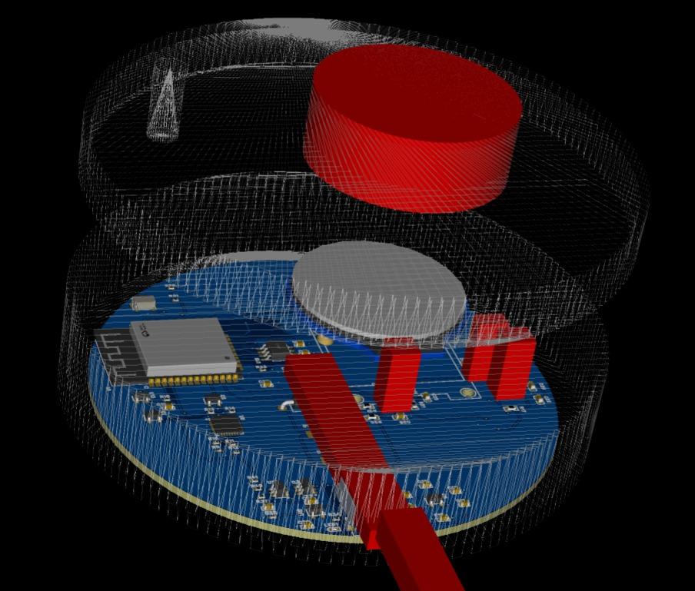
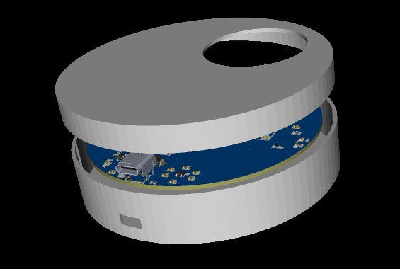
We are also developing a 3D design for our Vital Watch

Slide 31
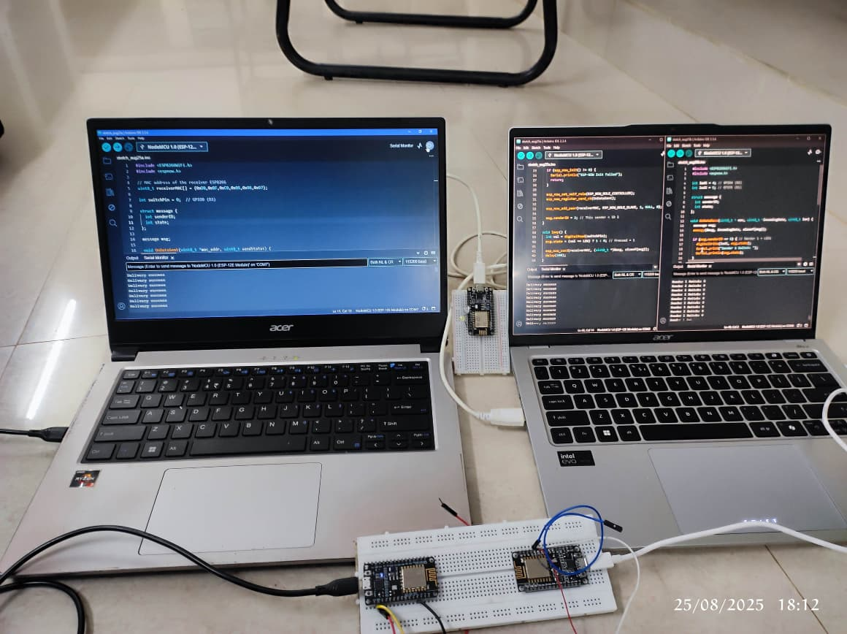
TESTING ESP-NOW PROTOCOL – MANY TO ONE

Slide 32
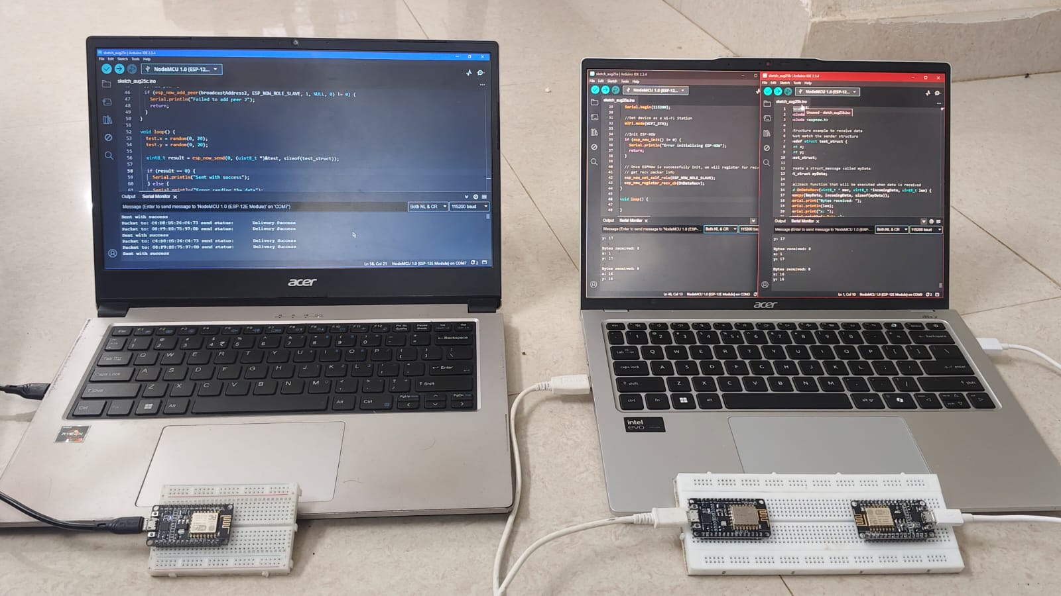
TESTING ESP-NOW PROTOCOL – ONE TO MANY

Slide 33
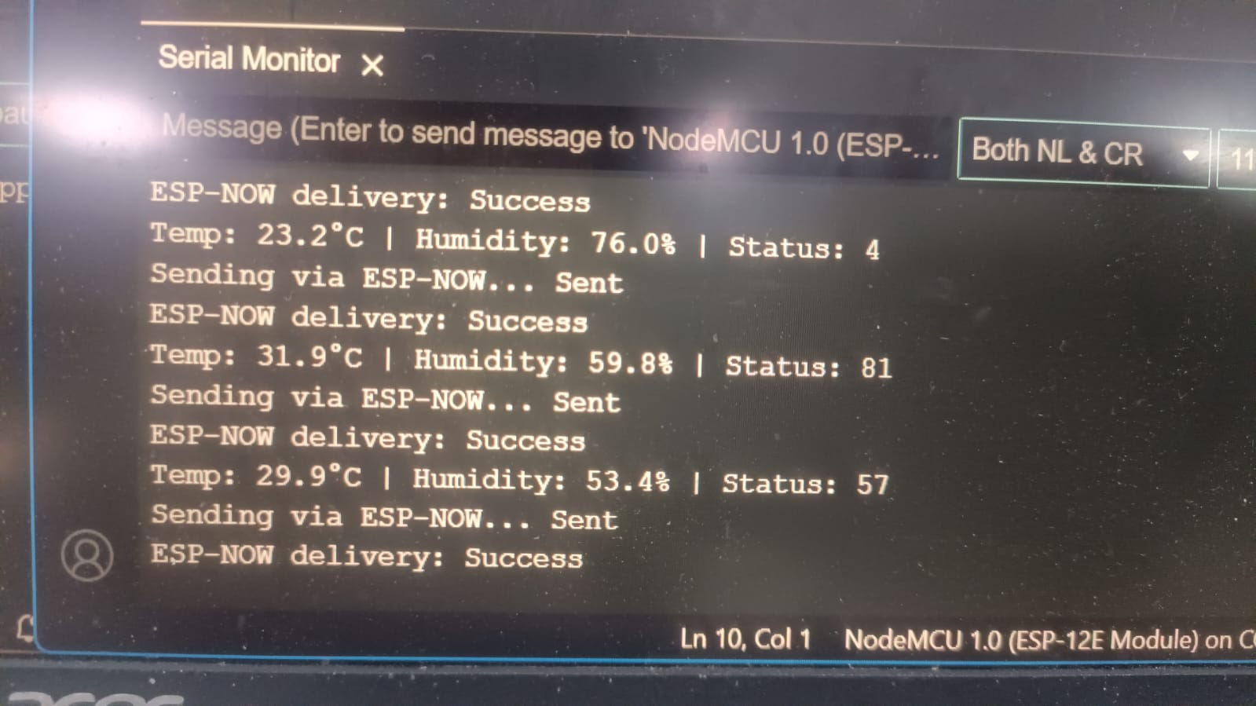
RECIEVING SENSOR DATA USING ESP NOW PROTOCOL

Slide 34
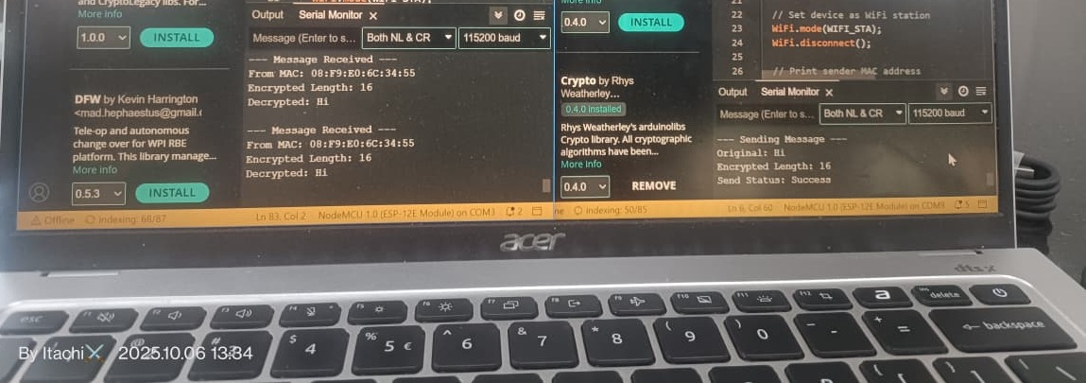

Slide 35
